Slide 1


Slide 2
Final project
1.Over view of project.
2.Requirement : objectives of creating admin page.
3.planning:requirements using tools
4.Design phase: creating ui & ux
5.Implementation phase: front_end & back_ end

Slide 3
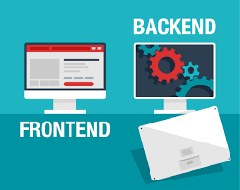
Using Front_END & Back_End

Slide 4
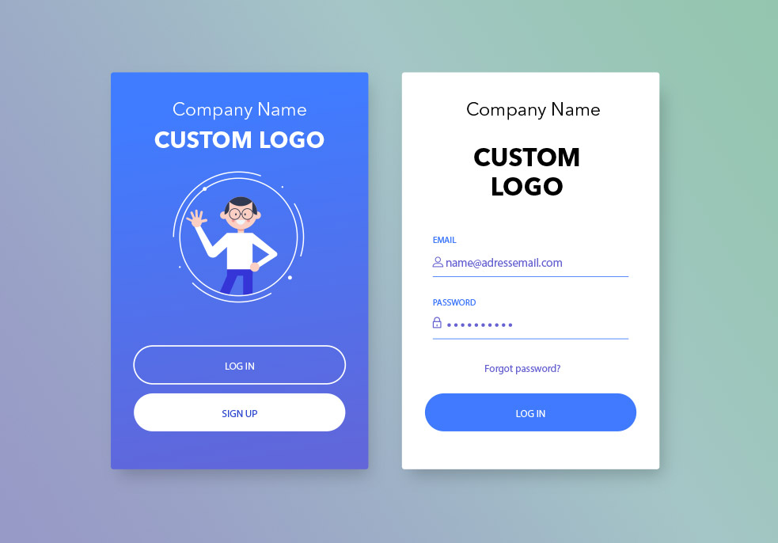
Creating admin page

Slide 5

OVER VIEW OF PROJECT
Start
|
|---> Admin Access Page
| |
| |---> Admin Login ---> Admin Dashboard
| | |
| | |---> User Management
| |
| |---> User Access Login Page
| |
| |---> User Authentication ---> User Dashboard
| |
| |---> Attendance Page ---> Attendance Tracking
| |
| |---> Daily Activities Page ---> Daily Activities
|
|---> Logout
|
End

Slide 6


